Slide 1



Computer Networks
Prepared & Presented by: Mirlan Nurbekov, Lecturer
Office hours: Friday 9:00–17:00
AlaToo IT & Business College
Fall 2025

Slide 2

The physical world
(Data transfer & storage)

Slide 3
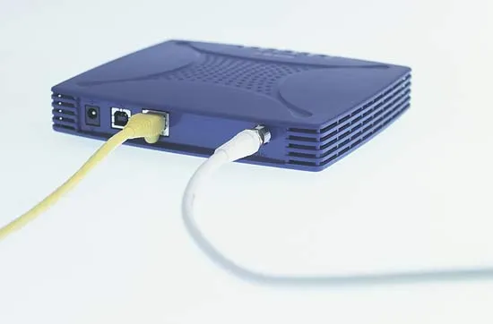
MODEM

Slide 4
MODEM – processes the signal from your Internet Service Provider (ISP), which may be delivered over a phone line, cable, fiber, or satellite link, and connects it to your home network. If you are only connecting one wired device to the internet, the modem is all you need. Just plug it into your device, and in most cases no configuration is required.

Slide 5
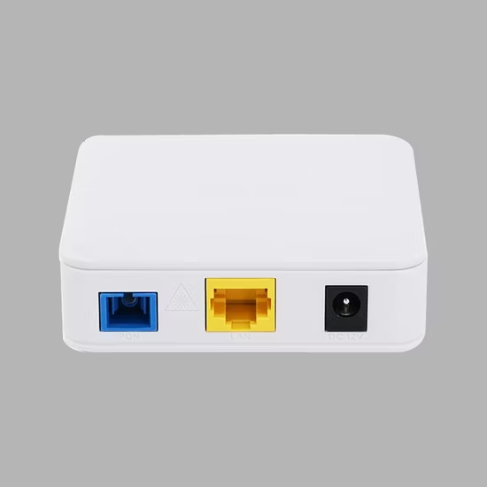
A modem by itself does not provide Wi-Fi. It only gives you ONE wired internet connection. That’s because its job is just to translate the ISP’s signal into internet data, not to share it with multiple devices.

Slide 6
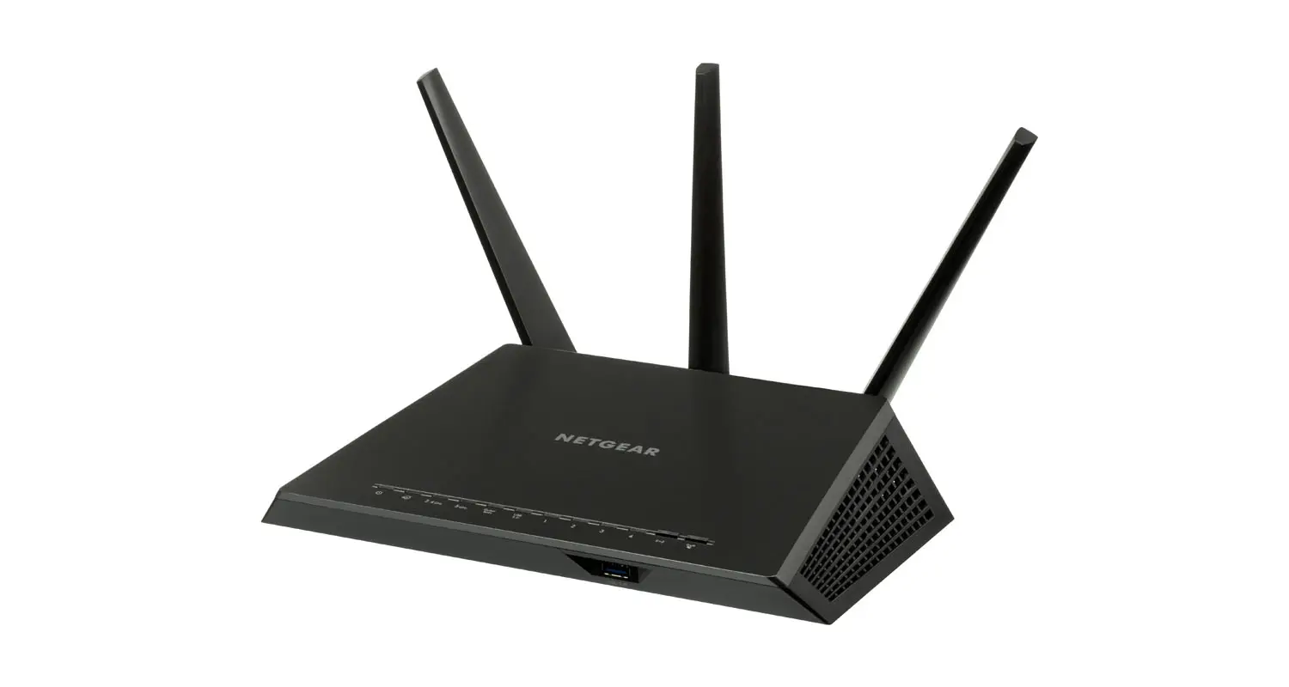
ROUTER

Slide 7
ROUTER – creates a local network (LAN) by assigning each device its own private IP address.
It works like an apartment building: all units share the same street address (the public IP from your ISP), but each unit has its own number (the private IP).
The router makes sure that internet traffic reaches the correct device inside your network.

Slide 8
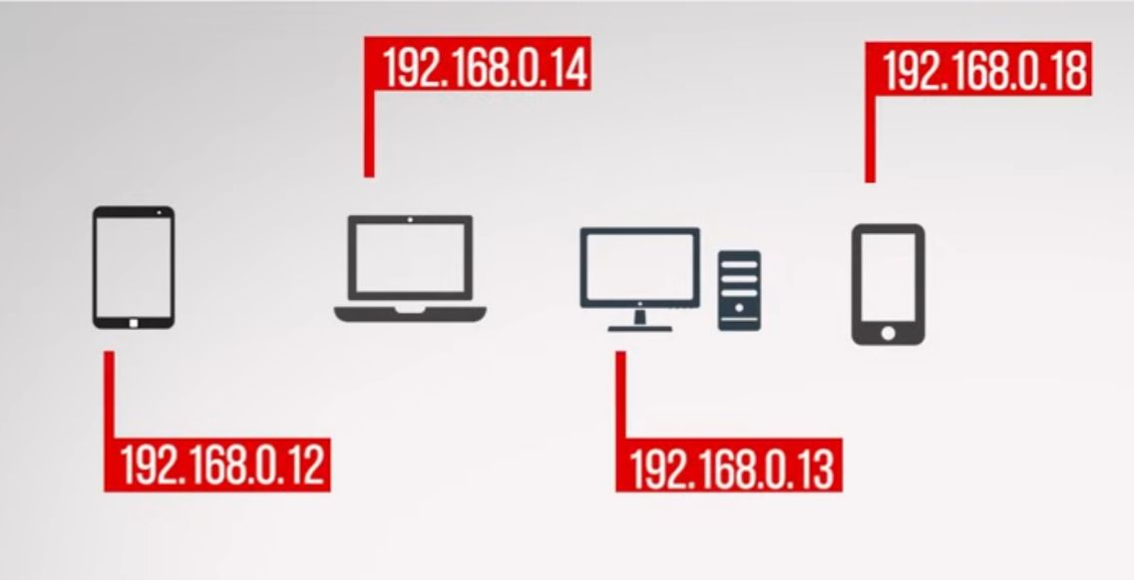

Slide 9
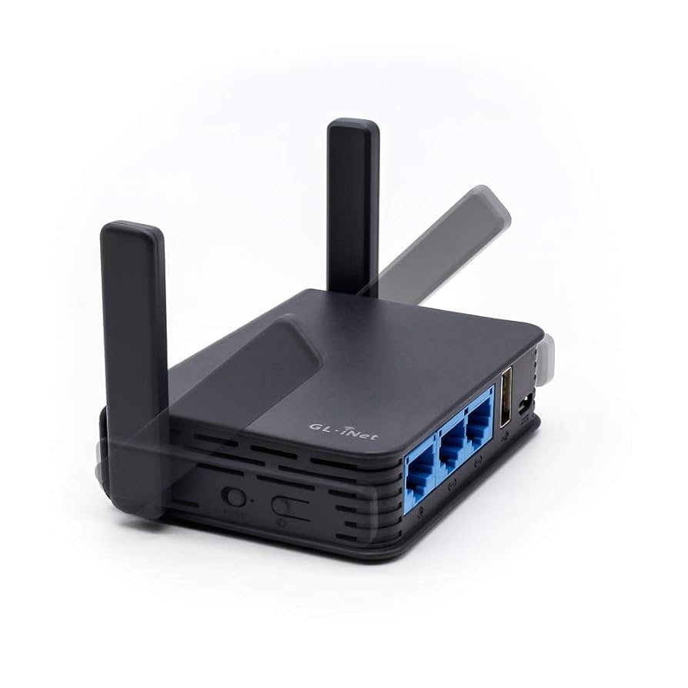
Routers are not wireless by definition.
Modern wireless routers are combination devices that include:
Router (to connect your network to the internet),
Switch (to connect multiple wired devices), and
Wireless Access Point (AP) (to provide Wi-Fi).

Slide 10
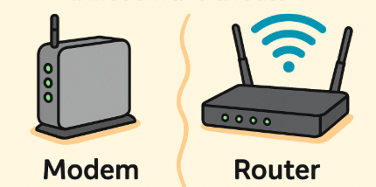

Slide 11
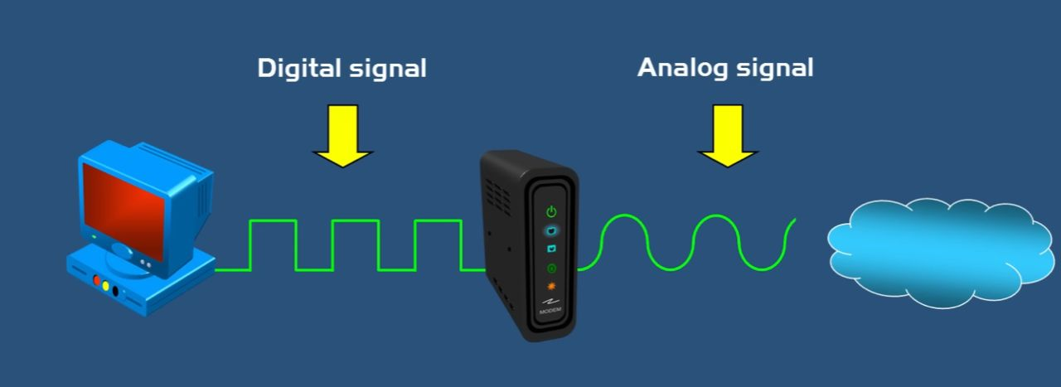

Slide 12
Modem demodulates incoming analog signals into a digital signal and modulates outgoing digital signals from the computer into analog signal for the internet. Noise resistance
Analog waveforms can be shaped (modulated) to use frequencies that are less affected by interference on the medium.
Bandwidth usage
By using different frequencies (like channels), analog signals allow multiple services (voice, TV, internet) to share the same cable or spectrum.

Slide 13
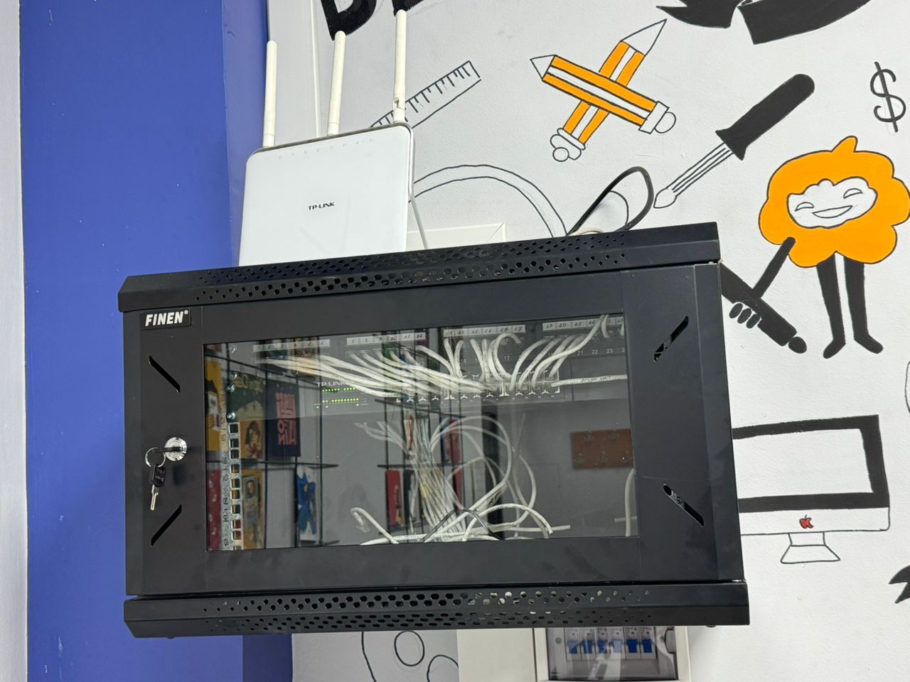
PATCH PANELS

Slide 14
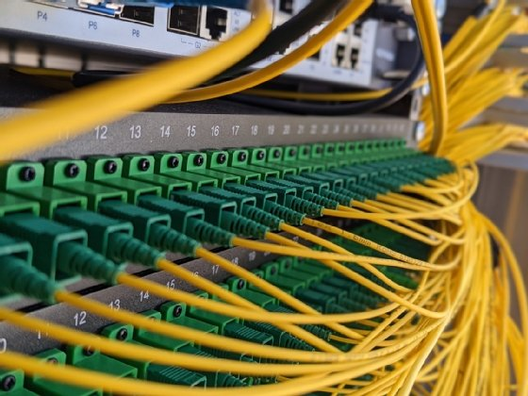

Slide 15
